Slide 1

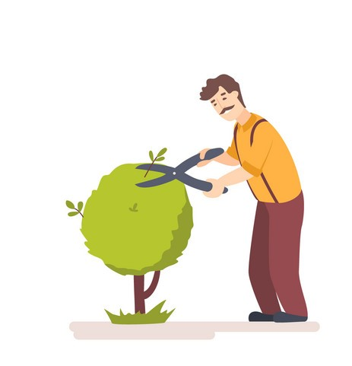
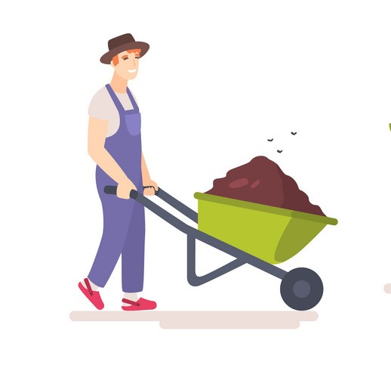
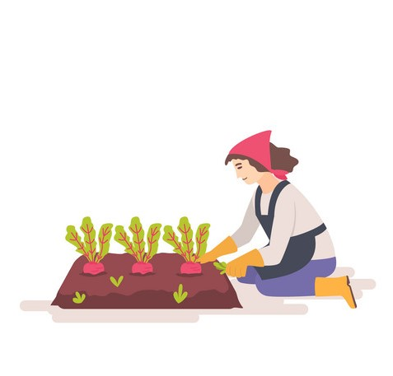
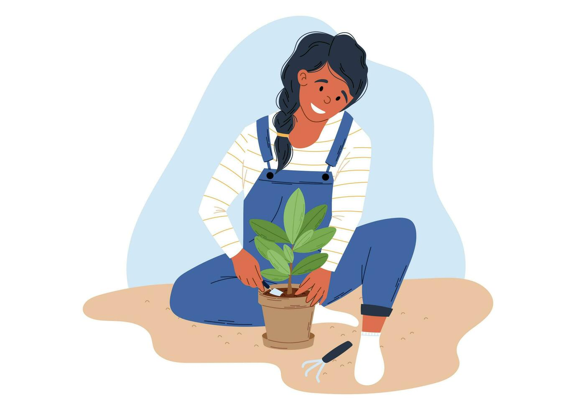
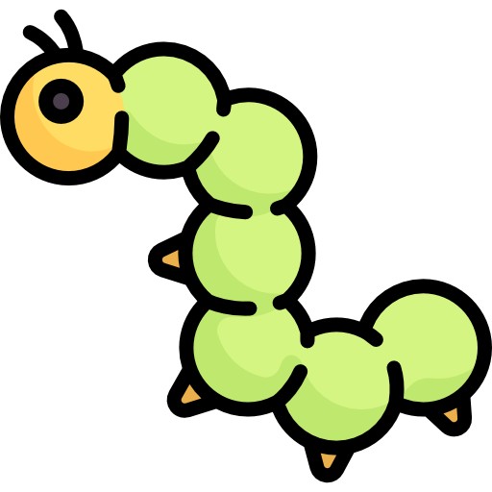
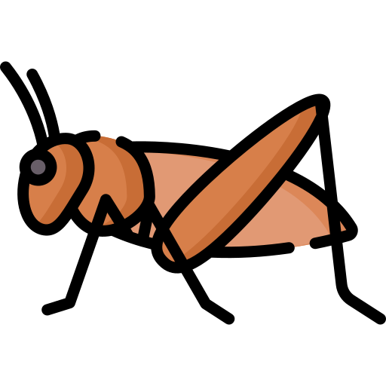
The origin
Notes:
Talk about the context, the study, etc

Slide 2

OLAF
Aurélien FERNANDEZ
Online Automated Farm
Notes:
Present OLAF

Slide 3
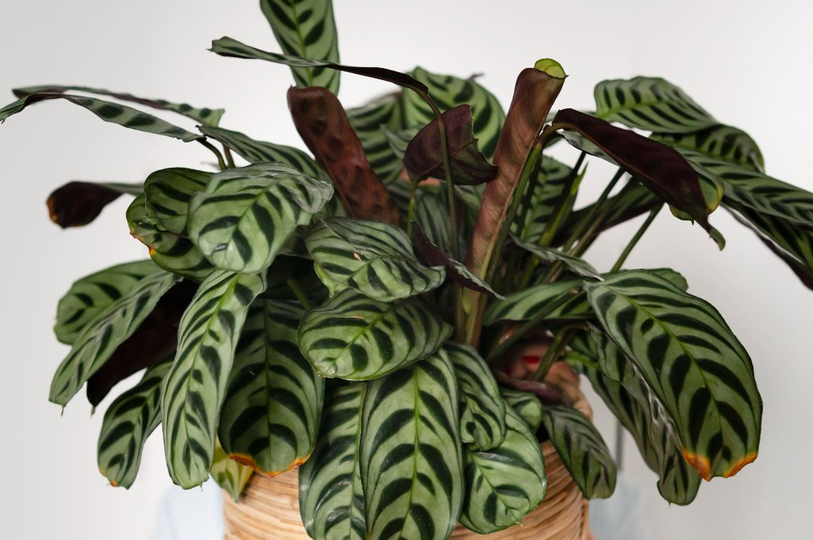
1. The initial objectives
An embedded system
A mobile app
Managing and monitoring a plant
Manage and check the status of your plants
Notes:
50 % of water used is lost

Slide 4
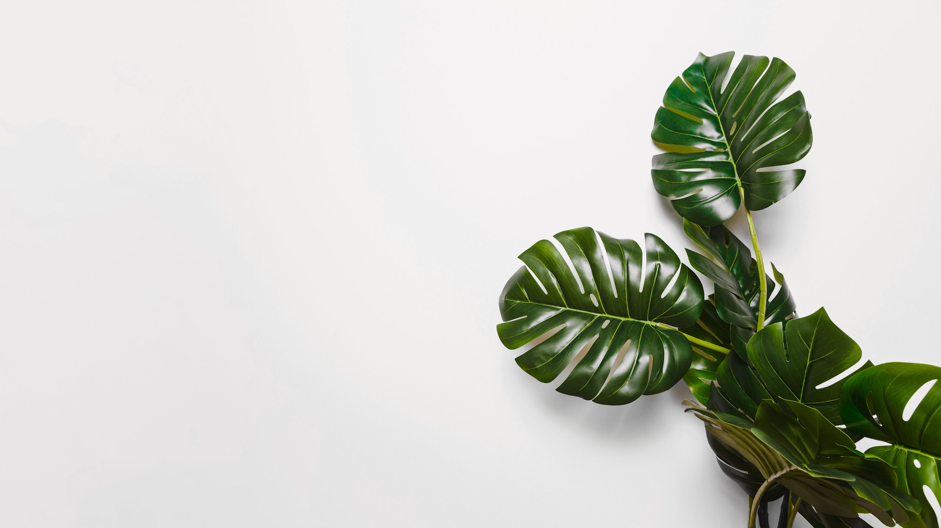
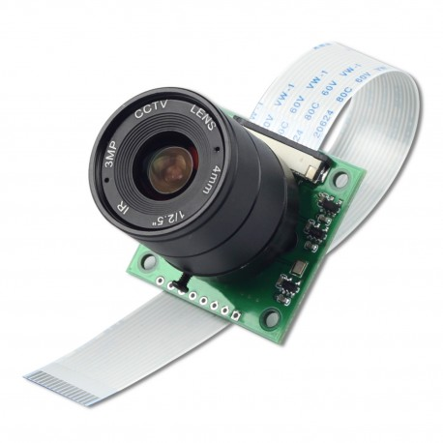
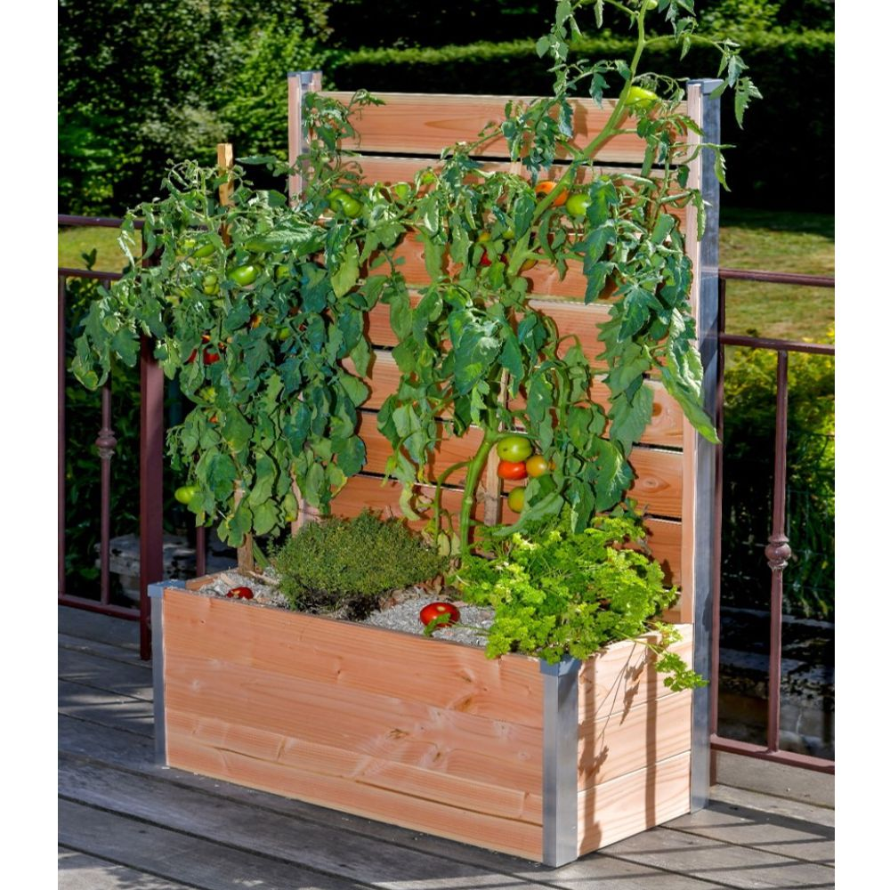
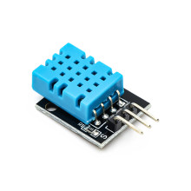
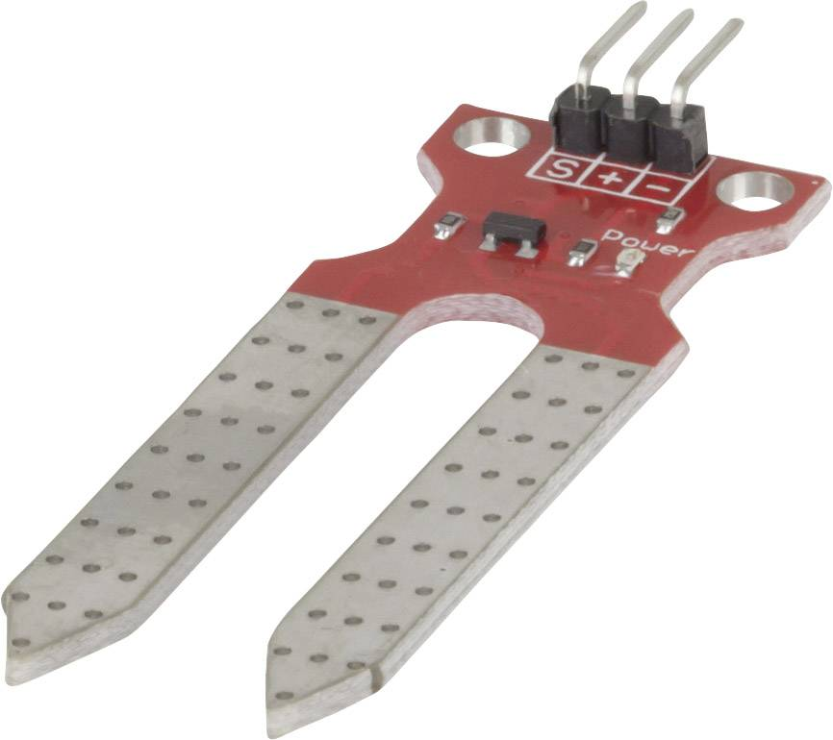
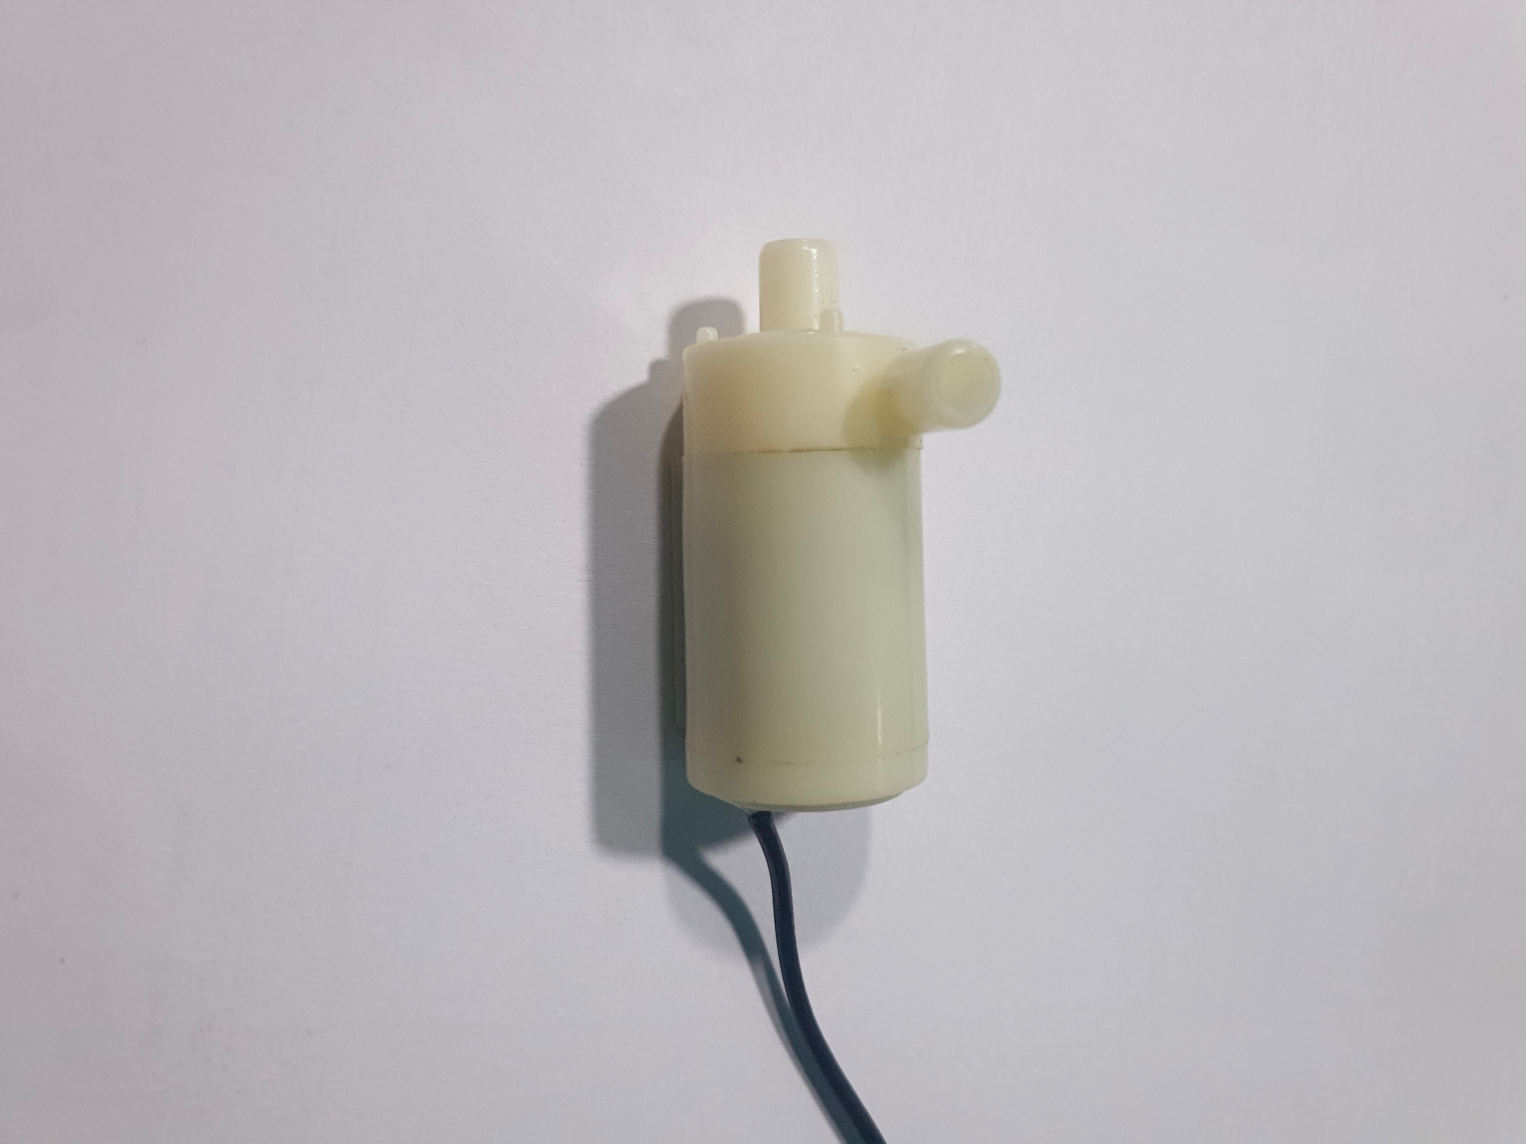
Notes:
Present the idea

Slide 5

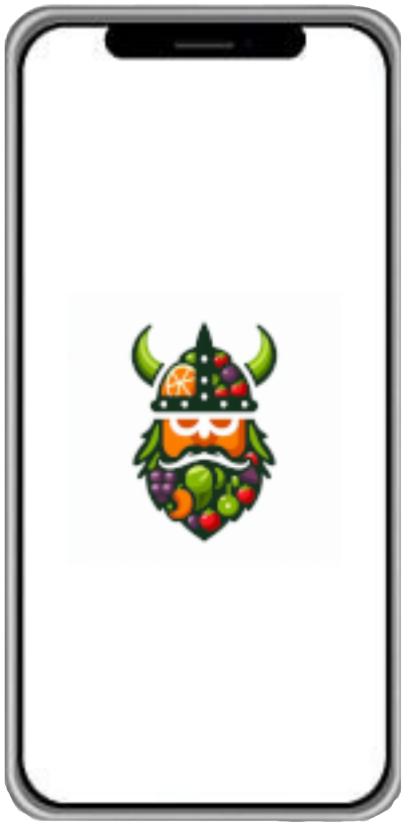
Notes:
Present the idea

Slide 6
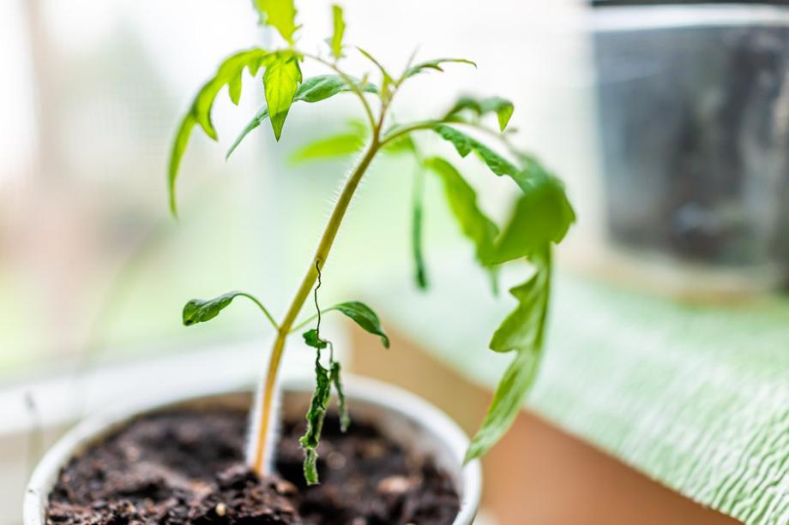
2. For Whom ?

Slide 7
Target audience
United states
89% ~293,255 Million
France
64%
~43.129 Million

Slide 8

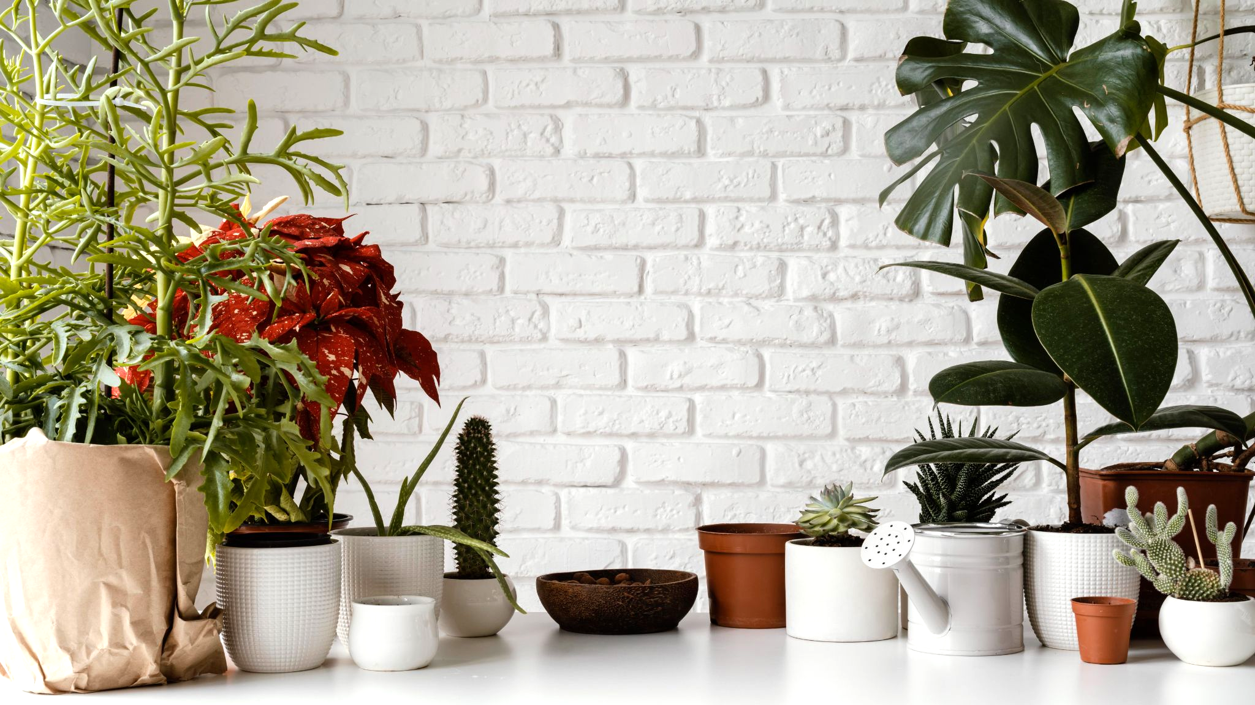
3. How Does it works

Slide 9




Aws
Flutter
AI
Raspberry
To store, process and transfer data
To create the mobile and the web app
To detect diseases from leaves
To create the intelligent plant pot

Slide 10



3 lambdas
1 S3
1 dynamodb
lexica-update
ai-update
image-analyzer
olaf-s3
olaf-s3

Slide 11
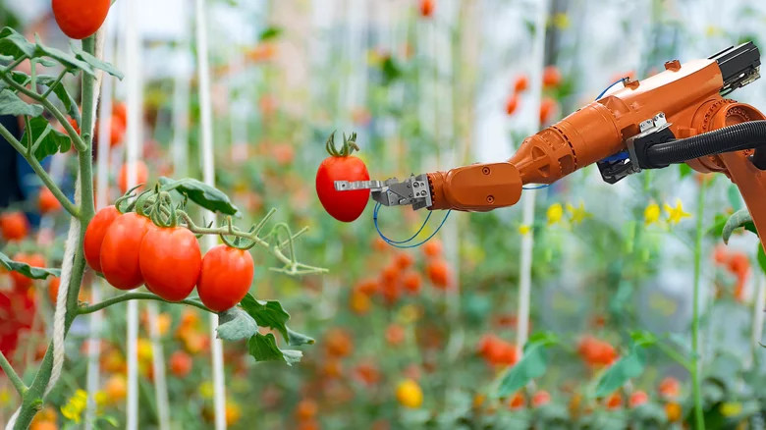
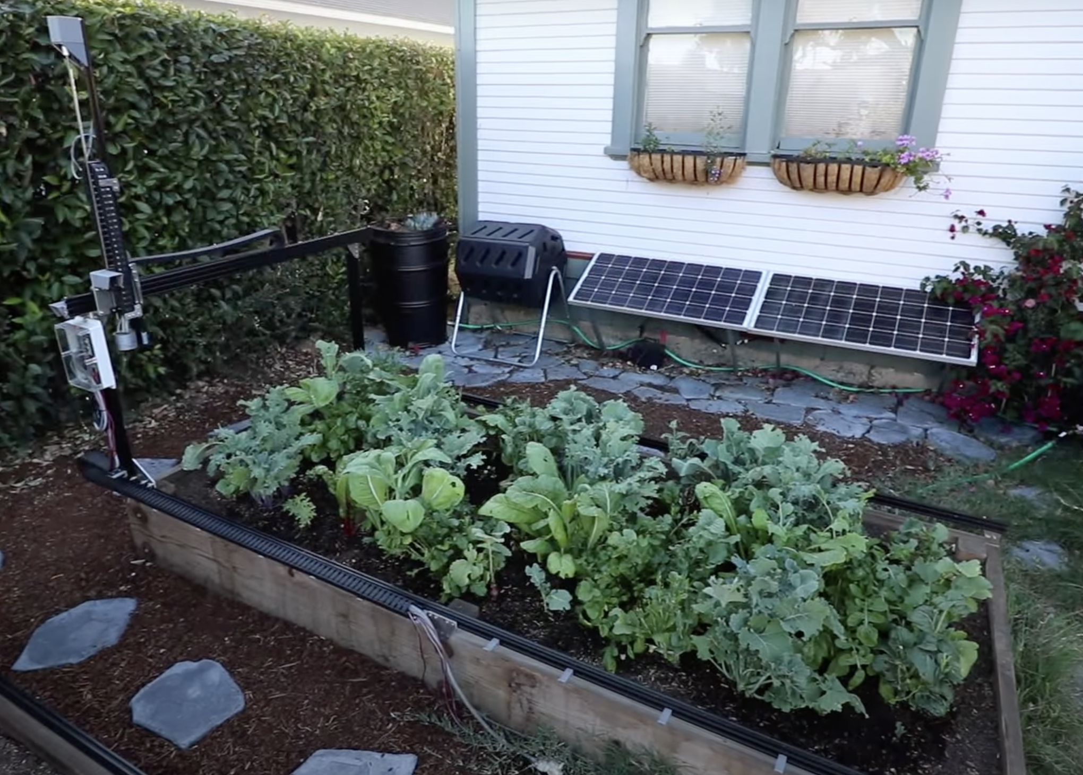
What is Already existing ?

Slide 12
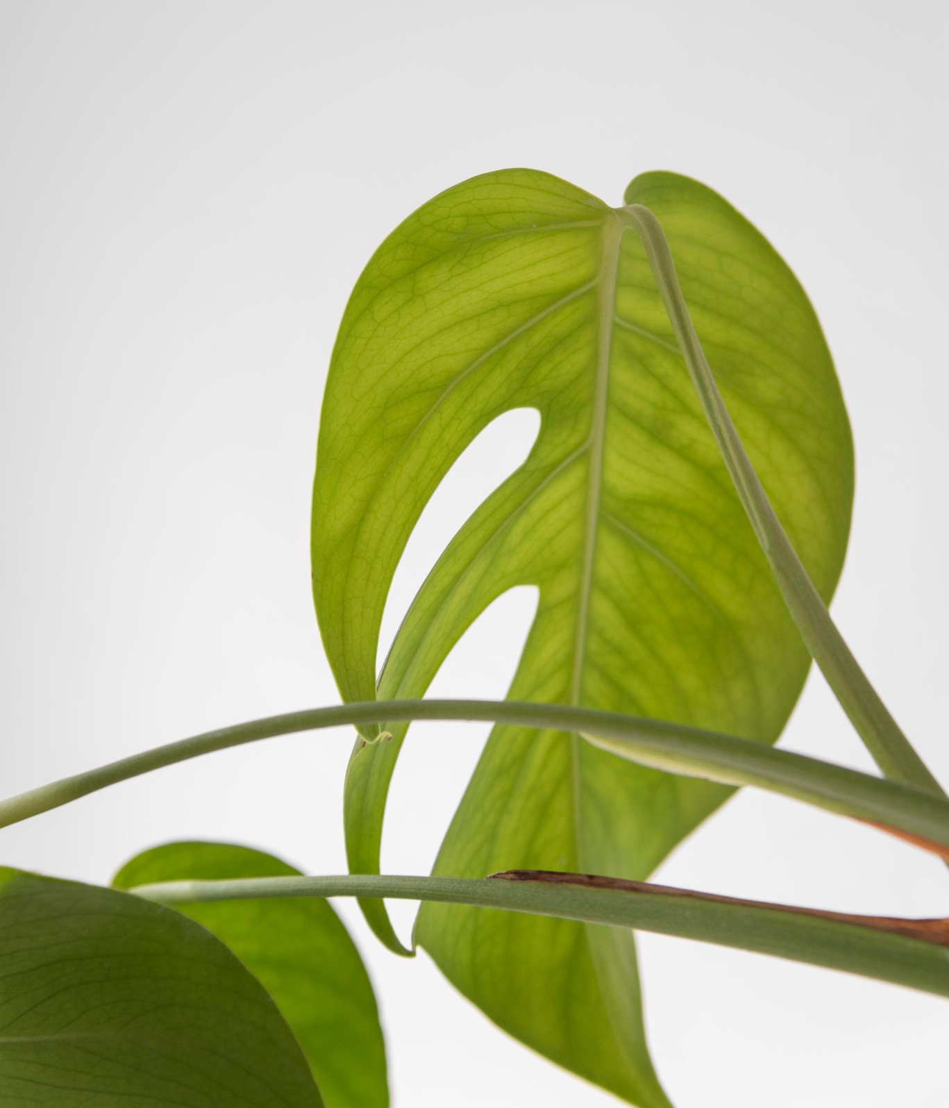
THANKS!
aurelien.fernandez@algosup.com
07 81 86 88 36
Do you have any feedback?
Please keep this slide for attribution

Slide 13
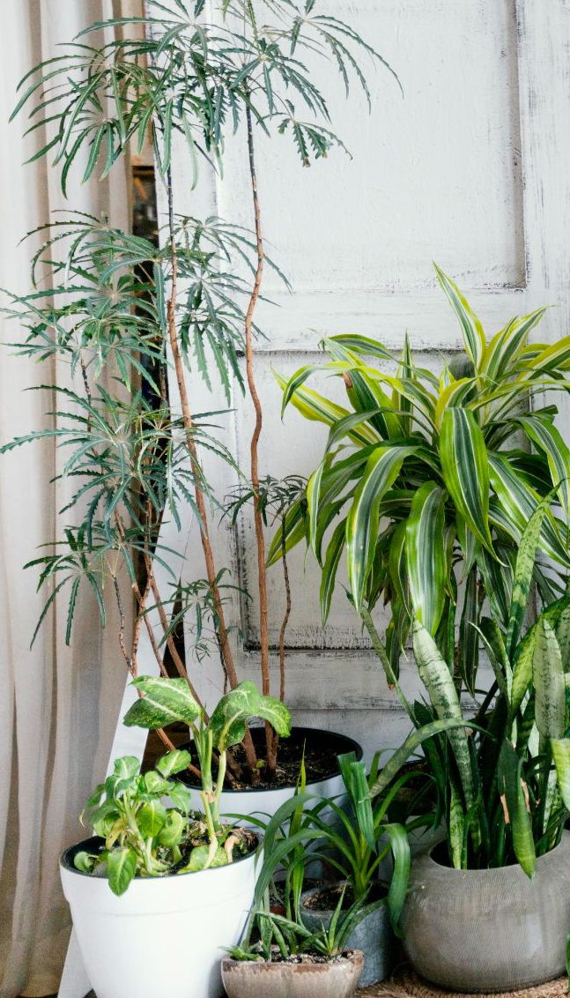
TABLE OF CONTENTS
01
02
Who am I
The problematic
03
04
What I propose
How does it works

Slide 14
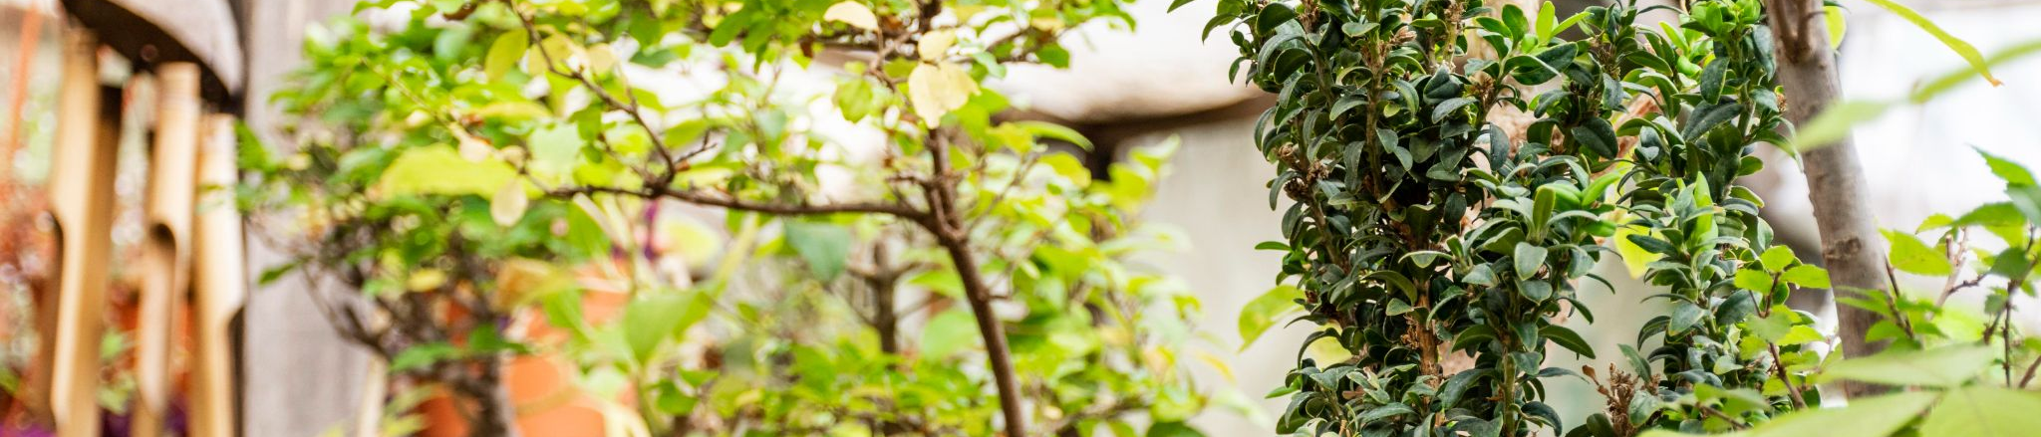
Potential Target
individuals
Botanists
Garden centers
People in apartment or in houses with a garden
Garden centers which care about their plants

Slide 15
RESOURCES
Did you like the resources on this template? Get them for free at our other websites:
PHOTOS
Plant pot on table close up
Room interior design
Close up plant leaves
Room interior design
Green monstera leaves on white backdrop
Decorative plant with empty frame
Minimal tropical leaf assortment
Decorative plant with empty frame
Minimal tropical leaf arrangement
Garden at home concept
Close up plants in garden
Front view of indoors plants in pots
Home garden arrangement with copy space
Abstract minimal concept plant and shadows
Close up woman holding flower pot
Plants pot with watering can

